Slide 1
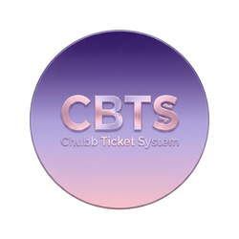


A Smart Ticket Service
CHUBB TICKET SYSTEM

Slide 2
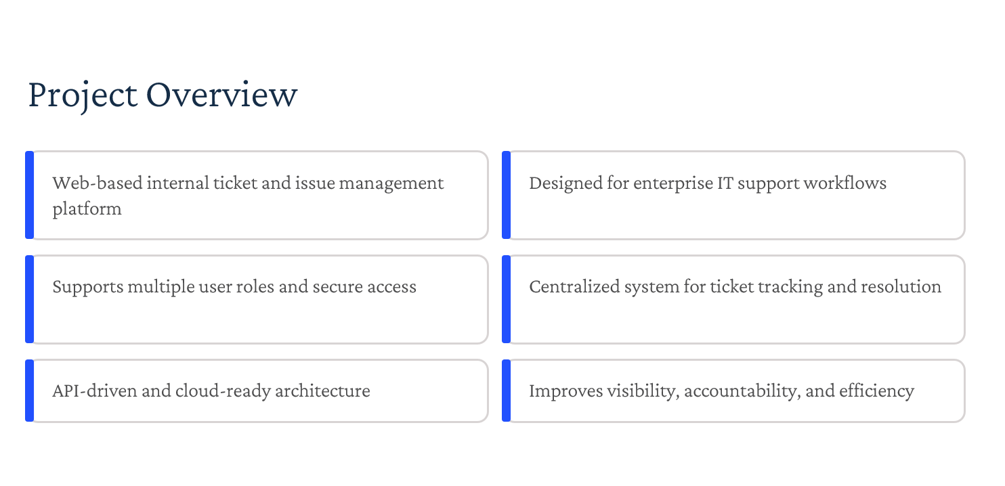
A Smart Ticket Service
Web-based application for managing support tickets within an organization
Allows users to report issues in a structured manner
Provides a complete workflow from ticket creation to resolution
Enables assignment of tickets to support agents
Tracks ticket progress and status in real time
Ensures timely issue resolution
Notes:
© Microsoft Corporation
2

Slide 3

A Smart Ticket Service
Problem Statement
In many organizations, issue tracking and support handling are done manually or using unstructured communication channels such as emails or spreadsheets. This leads to:
Delayed issue resolution
Lack of accountability
No clear ownership of tickets
Difficulty in tracking workload and performance
Poor visibility for management
There is a need for a centralized system that allows users to raise issues, enables managers to assign tickets efficiently, and allows agents to resolve issues in a structured and trackable manner.

Slide 4
A Smart Ticket Service
KEY FEATURES
RBAC
CENTRALIZED
SLA BASED
REPORTS
Role-based authentication and authorization
Users just have to raise tickets and track, everything else handled for them
Tickets monitored and if escalated, flagged as sla breached and taken utmost care of
Detailed, Downloadable reports for admin, managers and agents to keep track of their work

Slide 5
Tech Stack
Frontend
Database
Angular (Standalone Components)
Angular Material
TypeScript
HTML & CSS
ngx-charts
SQL Server Management Studio
Tools
Visual Studio
Visual Studio Code
Postman (API testing)
SQL Server Management Studio
Backend
ASP.NET Core Web API
Entity Framework Core
JWT Authentication

Slide 6
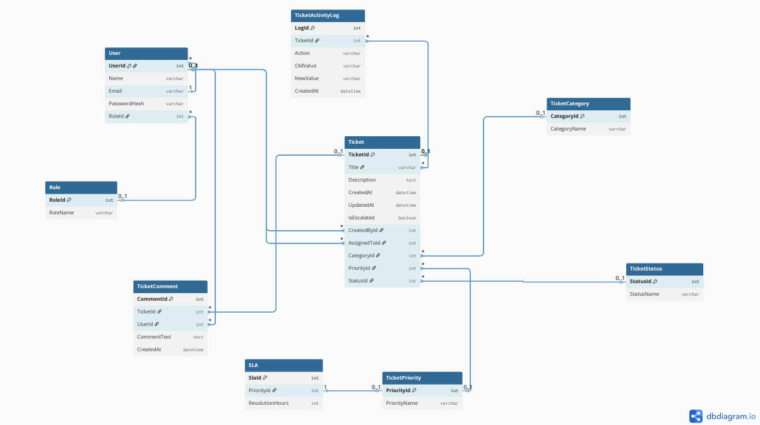
ER Diagram

Slide 7
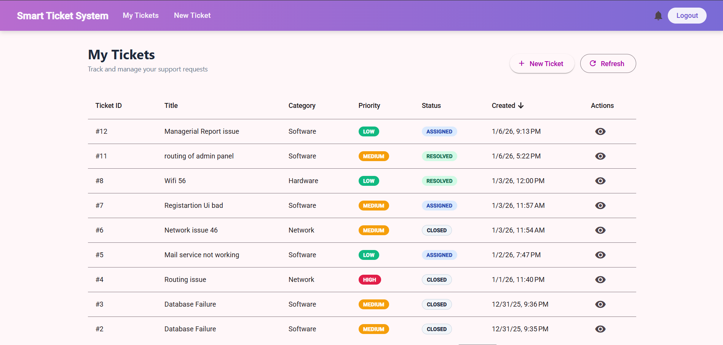
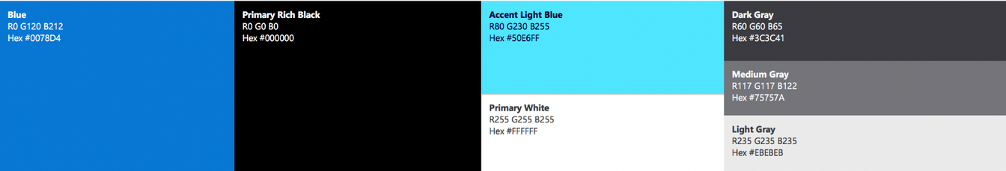
User DashBoard

Slide 8
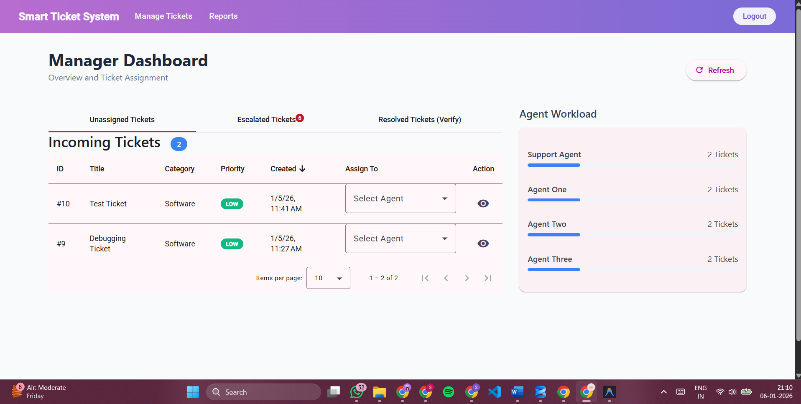

Slide 9
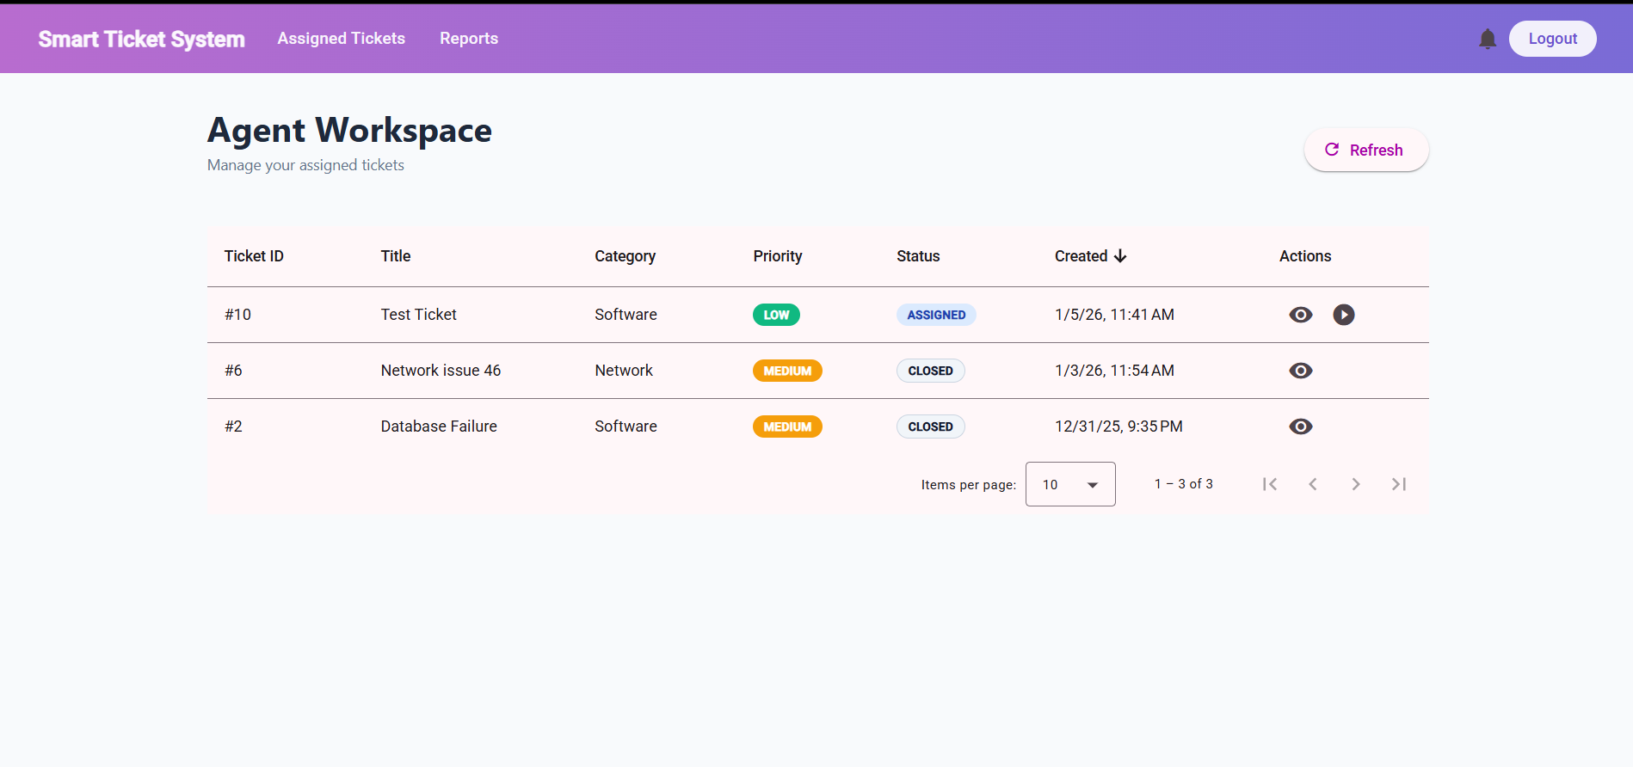
Agent DashBoard

Slide 10
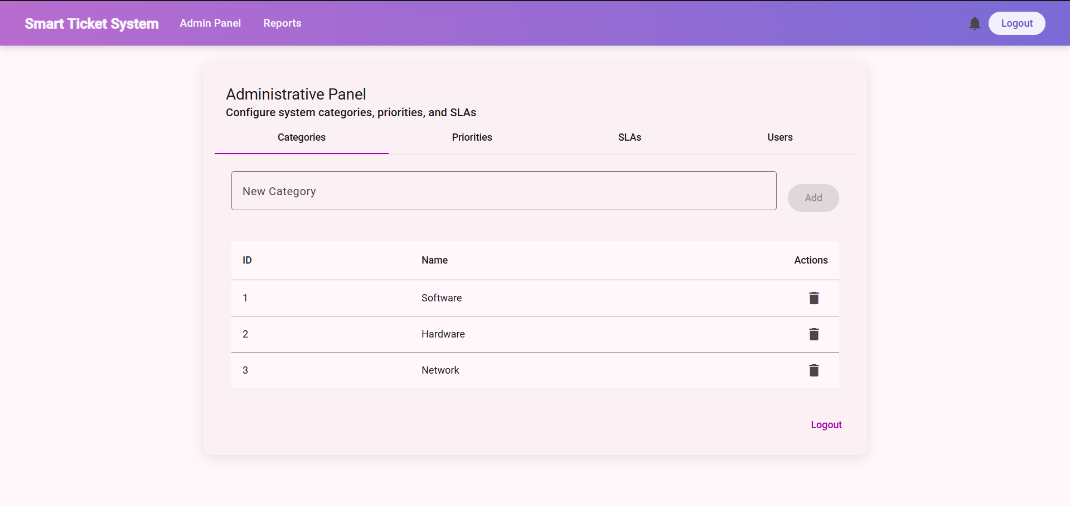
Admin DashBoard

Slide 11
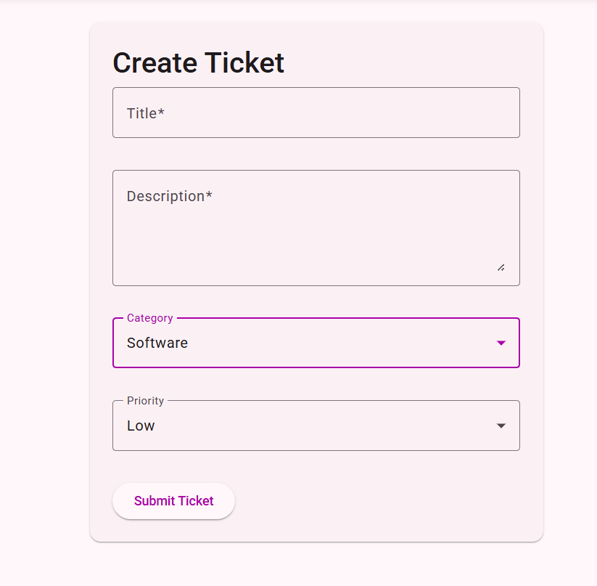
Create Tickets

Slide 12
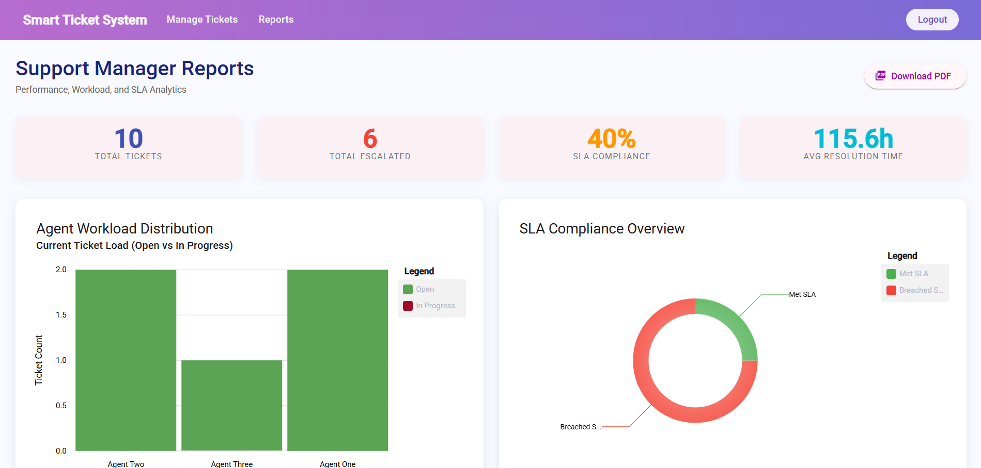
Reports & Analytics: Manager Report

Slide 13
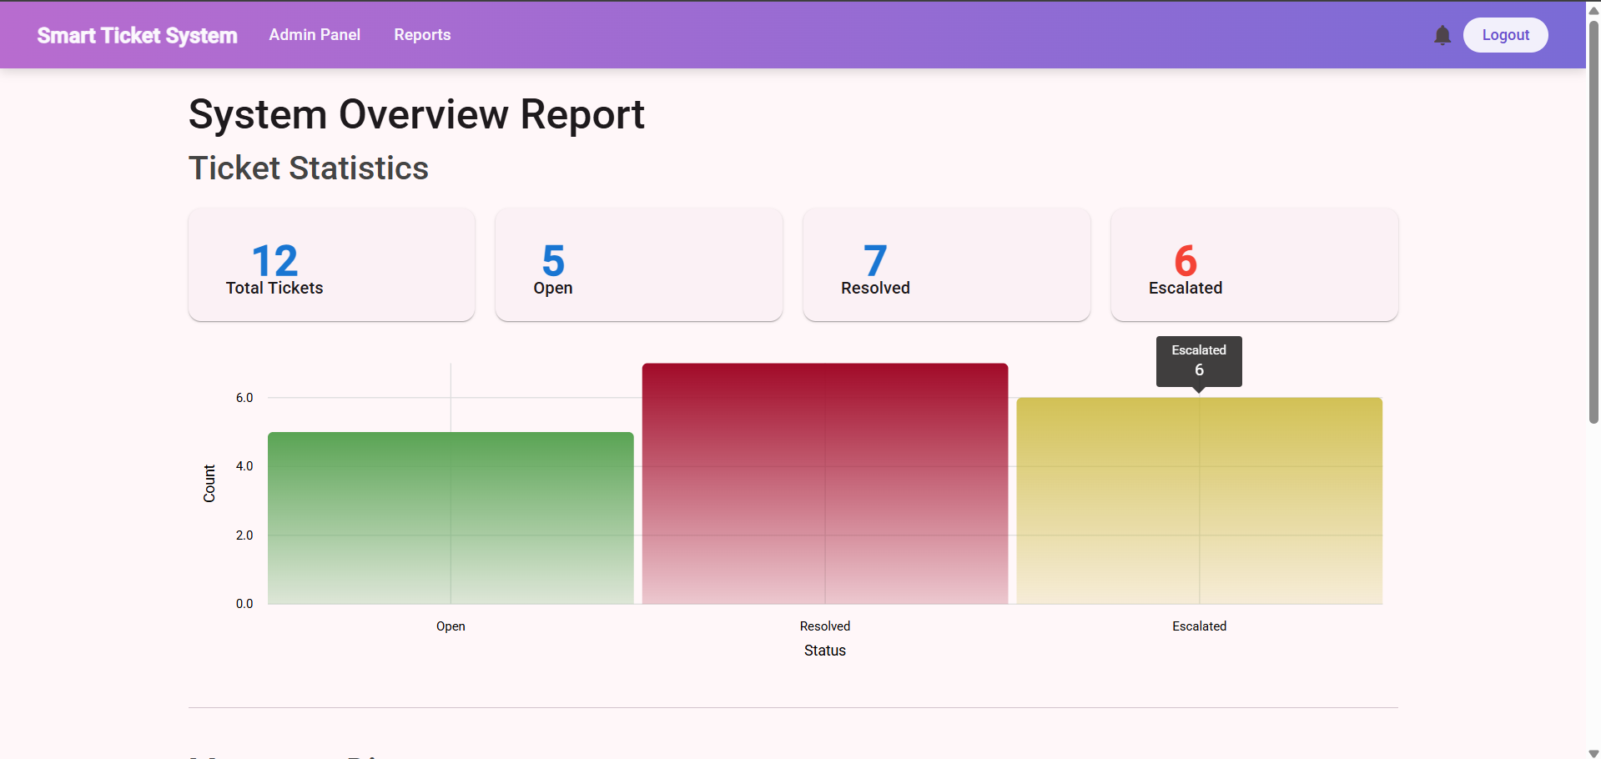
Reports & Analytics: Admin Report

Slide 14
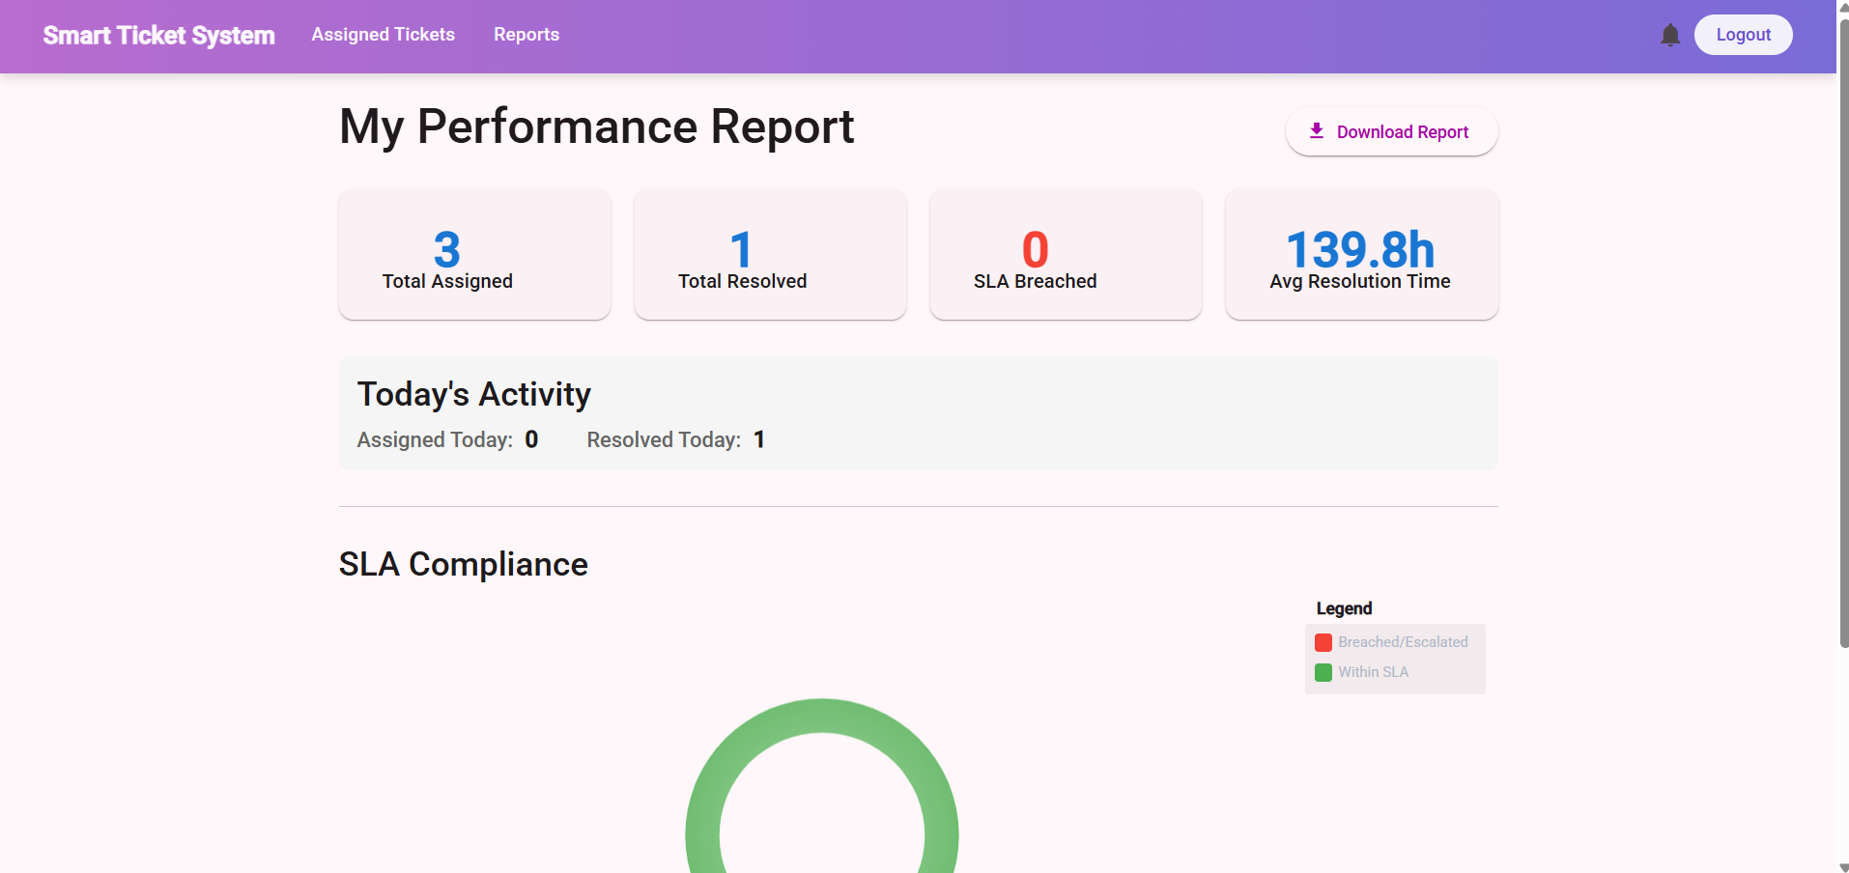
Reports & Analytics: Agent Report

Slide 15
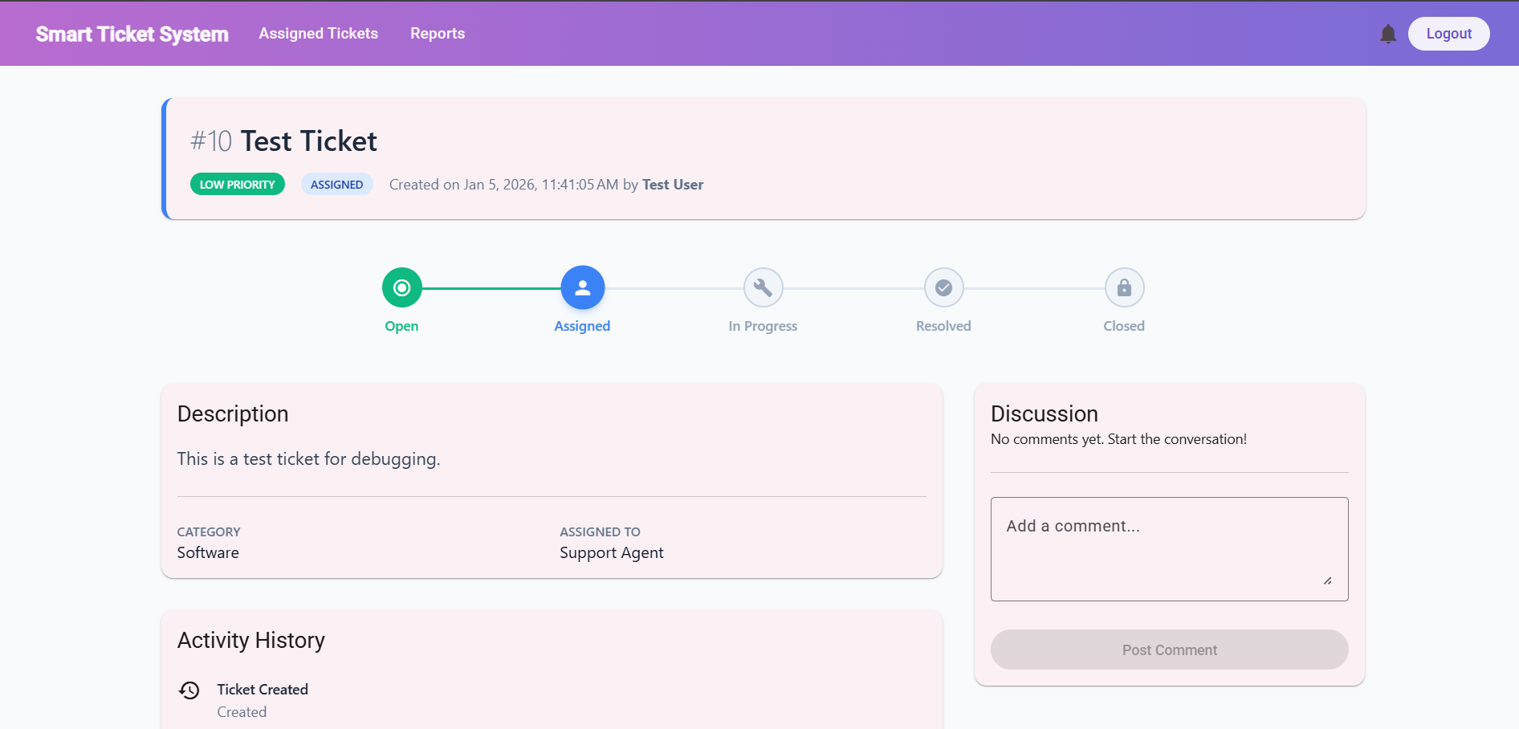
View Ticket Details

Slide 16
A Smart Ticket Service
Results and Achievements
Successfully implemented a full-stack enterprise application
Centralized and automated ticket management workflow
Secure and scalable backend with clean layered architecture
Modular and responsive Angular frontend
Improved ticket visibility and resolution tracking
Demonstrated real-world use of LINQ, JWT, and RBAC
Deployment-ready and well-documented solution

Slide 17
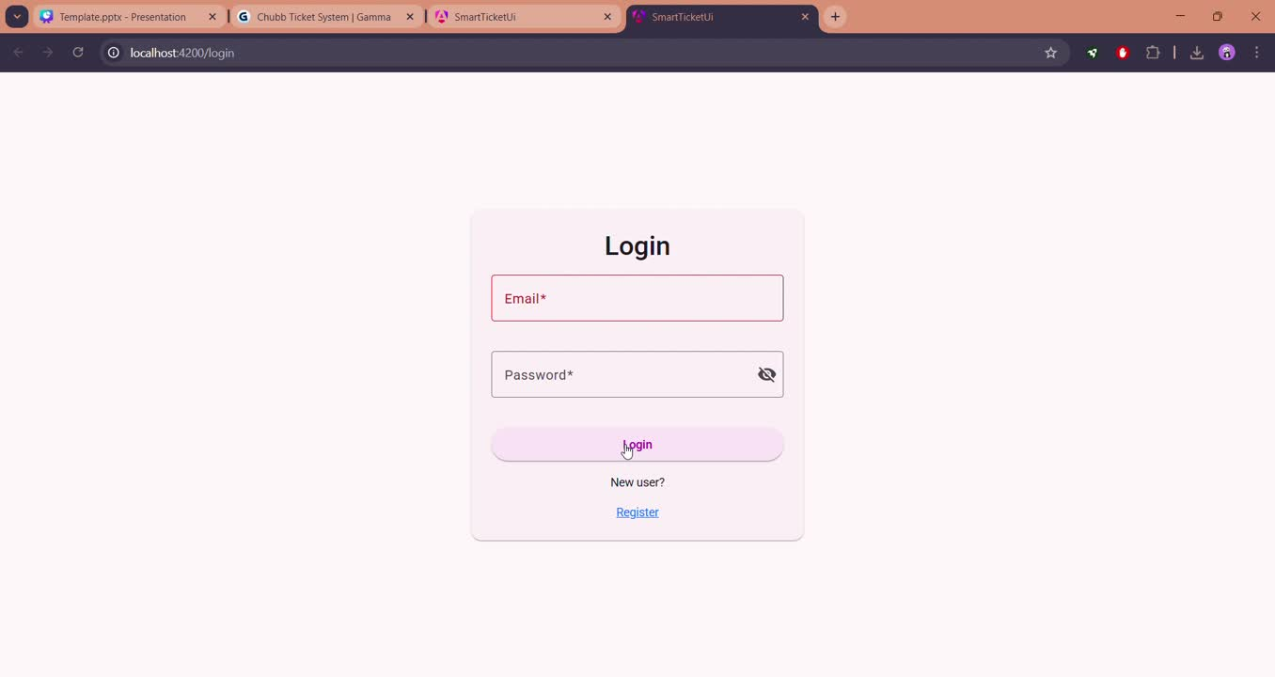
Live Demonstration

